Slide 1

Kolhapur Institute of Technology’s College of Engineering (Empowered Autonomous)
A Project Phase-II Presentation on :- | CCTV Footage Analysis Through Computer Vision and Deep Learning.
Presented By: Under Guidance of:
Pranav Mrs. K.M.Tamboli
Sham
Sanket
Tanish

Slide 2
GROUP MEMBERS
Name Roll No.
SHAM - 23
SANKET - 37
TANISH - 18
PRANAV - 28

Slide 3
PROBLEM STATEMENT
With the rapid growth of surveillance systems, large volumes of CCTV footage are generated every day, making manual monitoring and analysis time-consuming and inefficient. To address this challenge, Computer Vision and Deep Learning techniques can be used to automatically analyze video data and extract meaningful information.
This project focuses on developing a CCTV Footage Analysis System that detects objects such as people, vehicles, and other entities in surveillance videos and generates timestamped based on object attributes like type, color, and size. By converting visual information into structured, time-based descriptions, the system helps users quickly understand events occurring in the video without watching the entire footage.
The proposed system is useful in applications such as security monitoring, crime investigation, traffic analysis, and smart surveillance, where fast and accurate interpretation of video data is essential.

Slide 4
OBJECTIVES
Automate CCTV Video Analysis
Enable Attribute-Based Video Search
Convert Video Frames into Vector Representations
Create Timestamp-Based Indexing
Reduce Time Required for Video Investigation
Develop a User-Friendly Search Interface

Slide 5
LITERATURE REVIEW
Serial No. | Year of Publication | Title | Authors | Publications | Methododlogy | QOS Parameters | Limitations
1. | March 2024 | Design of a real‑time crime monitoring system using deep learning techniques | Md. Muktadir Mukto, Mahamudul Hasan, Md. Maiyaz Al Mahmud, kramul Haque | Intelligent Systems with Applications | Weapon detection using YOLOv5Violence detection using MobileNetv2Face recognition using LBPH (Local Binary Pattern Histogram) | Weapon detection: > 80% accuracy Violence detection: ~95% accuracy Face recognition: ~97% accuracy | Dataset dependencies, Computing requirements
2. | 2023 | Building Occupancy Detection and Localization Using CCTV Camera and Deep Learning | Shushan Hu Peng Wang Cathal Hoare James O’Donnell | IEEE Internet of Things Journal | Machine learning / deep learning models for detection. Real‑time alerts or classification of criminal behaviour. | detection rate, precision, recall | Model dependence on training data quality
3. | 2018 | Deep Learning Based Surveillance System for Open Critical Areas | Francesco TurchiniLorenzo SeidenariTiberio UricchioAlberto Del Bimbo | Inventions (MDPI) | Detecting objects (people, vehicles, etc.) using deep learning models. Tracking their movement through video streams. Counting objects and identifying anomalous behavior. | Object counting and detection accuracy in real‑world challenges | Dependence on video quality
4. | 2019 | Proposed System for Criminal Detection and Recognition on CCTV Data using Cloud and Machine Learning | Samit Shirsat, Aakash Naik, Darshan Tamse, Jaysingh Yadav | 2019 International Conference on Vision Towards Emerging Trends in Communication and Networking | The system uses CCTV cameras and OpenCV-based machine learning algorithms to detect and recognize faces. The detected faces are matched with a criminal database stored in the cloud to identify criminals automatically. | The system solves the problem of slow and inefficient manual monitoring of CCTV footage. | The system’s accuracy depends on lighting conditions and image quality of CCTV footage.

Slide 6
5. | 2025 | A Lightweight Real-Time CCTV Surveillance Framework for the Education Sector Using Machine Learning. | Naeem Ahmed, Abdullah Alqahtani, Fahad Alotaibi | Journal of Advances in Information Technology (JAIT) | Uses CCTV with machine learning (Haar Cascade, FaceNet, SVM) to detect and recognize people in real time. | Provides automated real-time surveillance and improves security by detecting unauthorized persons quickly. | Accuracy may reduce due to poor lighting or image quality and requires good dataset and computing resources.
6. | 2021 | Deep Learning Based Smart Surveillance System for Suspicious Activity Detection | A. K. Singh, P. K. Singh, and other co-authors | Materials Today: Proceedings (Elsevier / ScienceDirect) | Uses deep learning to analyze CCTV video frames and detect suspicious activities automatically. | Reduces manual CCTV monitoring and enables automatic detection of suspicious behavior. | Performance may reduce due to poor video quality and requires large datasets and high computation.
7. | 2021 | Design of an Intelligent Video Surveillance System for Crime Prevention: Applying Deep Learning Technology | Chang-Soo Sung, Joo-Yeon Park | Multimedia Tools and Applications (Springer) | Uses deep learning with CCTV video analysis to automatically detect suspicious activities and crimes in real time. | Reduces manual CCTV monitoring and enables automatic crime detection for faster response. | Performance may be affected by complex environments and video quality, and deep learning models require large training data and high computation.
8. | 2022 | AI-Based Intelligent Video Surveillance System for Security Monitoring | A. Al-Ghamdi, M. Al-Harbi, and other co-authors | Abu Dhabi International Petroleum Exhibition & Conference (ADIPEC) | Uses AI and computer vision to analyze CCTV video streams and detect suspicious activities automatically. | Provides real-time automated surveillance and reduces manual monitoring effort. | Performance may depend on video quality and computational resources.
9. | 2024 | Design of a Real-Time Crime Monitoring System Using Deep Learning Techniques | Md. Muktadir Mukto, Mahamudul Hasan, Md. Maiyaz Al Mahmud | Intelligent Systems with Applications (Elsevier / ScienceDirect) | Uses deep learning with CCTV surveillance to detect crimes in real time through weapon detection, violence detection, and face recognition. | Automates crime monitoring and reduces human CCTV supervision by detecting criminal activities instantly. | Accuracy may depend on dataset quality and computational resources for deep learning models.

Slide 7
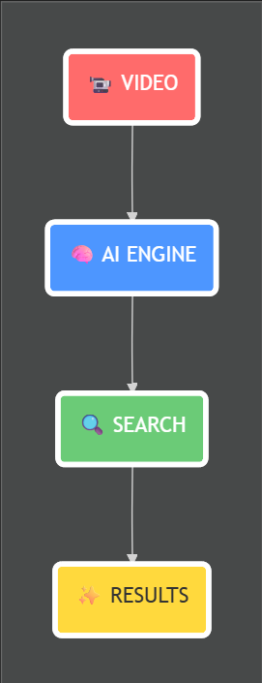
DATA FLOW DIAGRAM

Slide 8
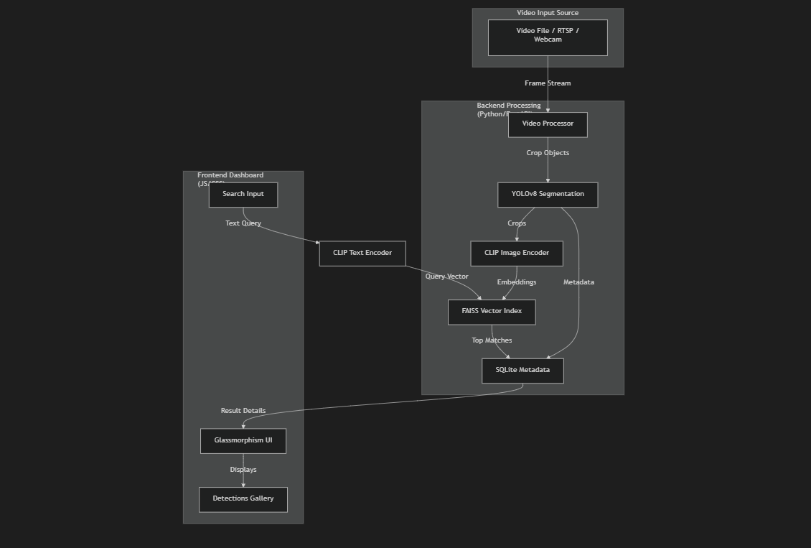
SYSTEM ARCHITECTURE

